Slide 1
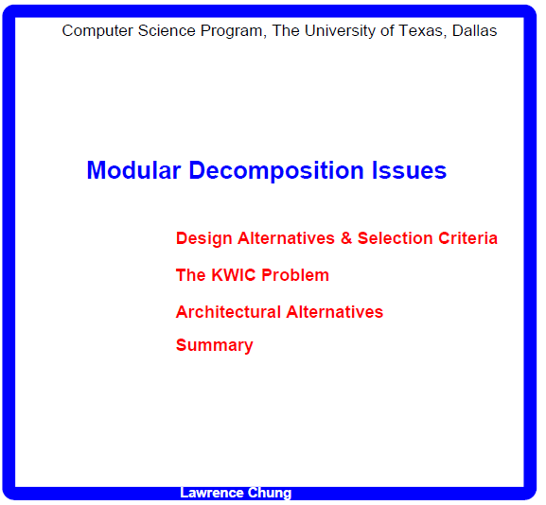
Software Engineering

Slide 2
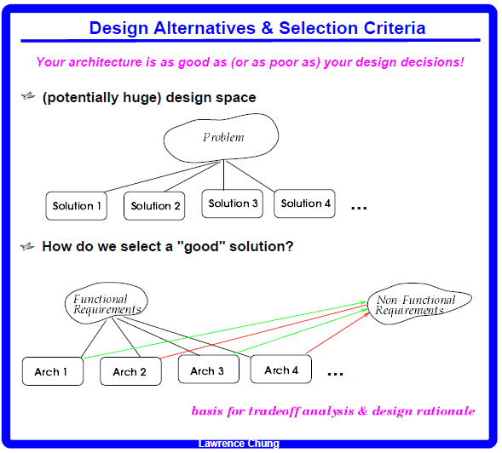
Design Alternatives
Selection Criteria

Slide 3
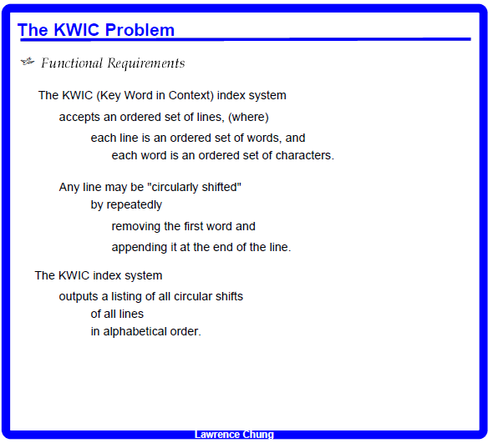
Circle of life
of life Circle
life Circle of
Circle of life
Beauty and the beast
and the beast Beauty
the beast Beauty and
beast Beauty and the
Beauty and the beast
and the beast Beauty
beast Beauty and the
Beauty and the beast
Circle of life
life Circle of
of life Circle
the beast Beauty and
what is what is
is what is what
what is what is

Slide 4
Beauty and the beast
and the beast Beauty
the beast Beauty and
beast Beauty and the
Circle of life
of life Circle
life Circle of
and the beast Beauty
beast Beauty and the
Beauty and the beast
Circle of life
life Circle of
of life Circle
the beast Beauty and

Slide 5
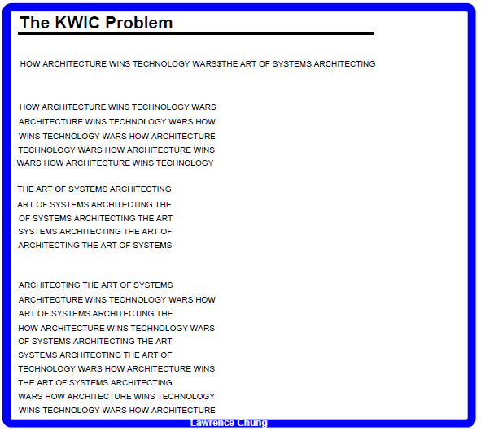
Circular shifts
Alphabetized
Circular shifts

Slide 6
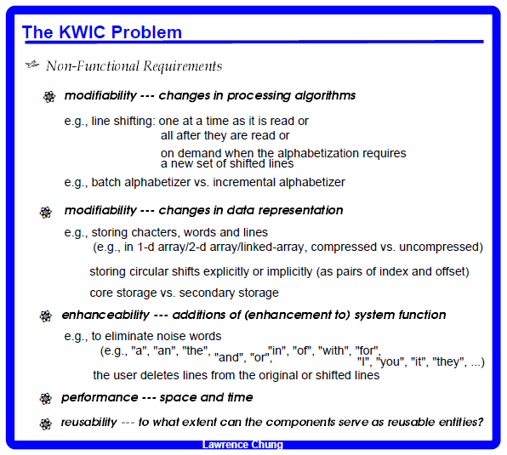
Scenarios
Scenario Analysis

Slide 7
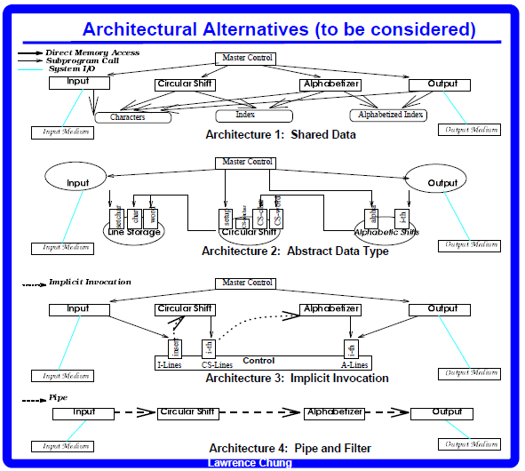
De facto standard 70’s-90’s
Functional descriptions
OO – current de facto standard
Many possible styles, and many architectures in each style

